Slide 1

Political culture
Hasan Muhammad Baniamin

Slide 2
Hierarchical culture vs egalitarian culture
Who are more successful to reach to the top of the Everest?
Who die more along the path of reaching the top of Mount Everest?

Slide 3
Political Culture and Political Ideology
The term 'political culture' refers to historically-based, widely-shared beliefs, feelings, and values about the nature of political systems, which can serve as a link between citizens and government.
The term 'political ideology' refers to a code of beliefs or views about governments and politics that may influence the way we vote or whether or not we support certain legislative actions.

Slide 4
Difference between Political Culture and Political Ideology
Two people can share a political culture, but have different political ideologies.
For example, a right-wing conservative can be from the same political culture as a left-wing liberal.
In other words, political culture is something we share, while a political ideology is something we use to define ourselves and make political decisions.

Slide 5
Types of political culture
Two political scientists, Gabriel Almond and Sydney Verba, published a study of the political cultures associated with five democratic countries: Germany, Italy, Mexico, the United Kingdom, and the United States.
According to Almond and Verba, there are three basic types of political culture, which can be used to explain why people do or do not participate in political processes. They are:
  Parochial political culture
  Subject political culture
  Participant political culture

Slide 6
Types of political culture
In a parochial political culture, like Mexico, citizens are mostly uninformed and unaware of their government and take little interest in the political process.
In a subject political culture, such as those found in Germany and Italy, citizens are somewhat informed and aware of their government and occasionally participate in the political process.
In a participant political culture, like the United Kingdom and the United States, citizens are informed and actively participate in the political process.

Slide 7
Social media and culture
Cancel culture is defined as campaigns using social pressures which attempt to ostracize someone for violating perceived social norms and moral standards

Slide 8
Theories
Political culture takes root and is transferred from generation to generation through political socialization and include Seymour Martin Lipset's formative events theory, which describes the long-lasting effects of key events that took place when a country was founded
Louis Hartz's fragment theory, which explains the long-lasting effects of European colonization on countries and societies.
Roger Inglehart's post-materialism theory, which explains the long-lasting effects of childhood economic and social conditions.

Slide 9
Post-materialism
It mainly indicates the rise of self-expressive citizens who are critical of their government’s performance.
Citizens with post-materialist values increasingly challenge elitist rule and reject authority.
They are less satisfied with the performance of institutions than are the materialists.
When this happens, post-materialist citizens’ do not concern about traditional socio-economic development, rather tend to demonstrate interest on different issues like political rights and liberty, equality, tolerance, participation, cosmopolitanism, multiculturalism, environmental concerns and human rights issues.

Slide 10
Theoretical Arguments to Explain Trust in Civil Service
Performance
  Economic Performance
  Political Freedom
  Quality of Governance (neutrality and fairness)

Slide 11
What do you expect for Bangladesh in terms of trust?

Slide 12
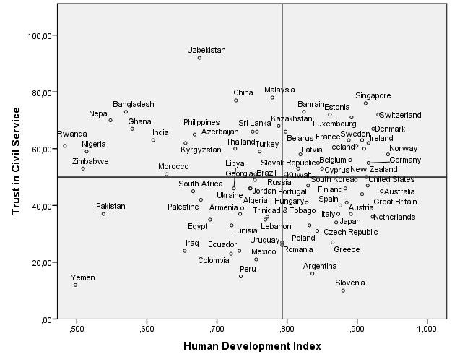
Empirical Evidences
Q 2
Q1
Q 3
Q 4

Slide 13
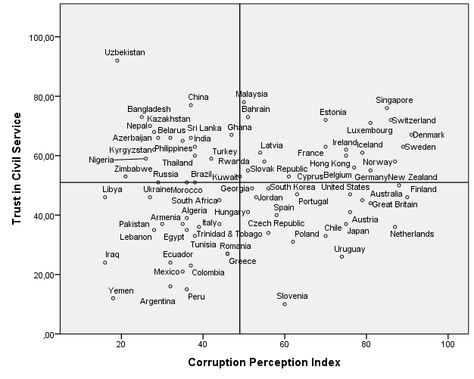
Empirical Evidences (Contd.)
Q 2
Q1
Q 3
Q 4

Slide 14
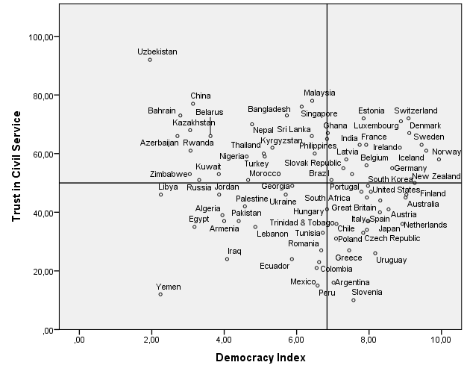
Empirical Evidences (Contd.)
Q 2
Q1
Q 3
Q 4

Slide 15
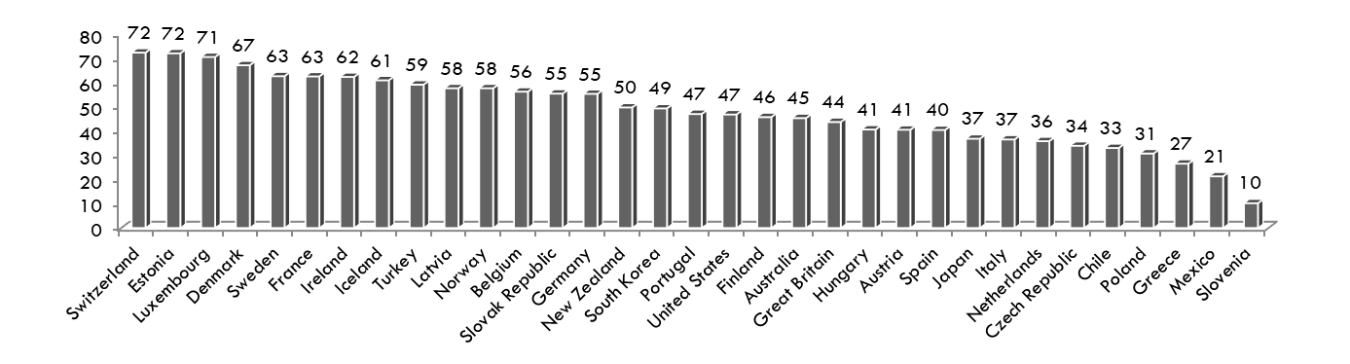
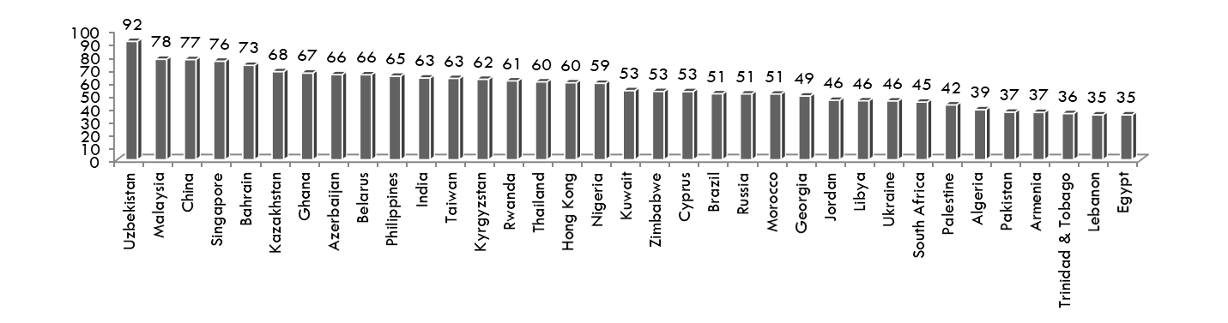
Trust in Civil Service ( WVS 6)
Figure: Confidence in Civil Service in OECD countries
Figure: Confidence in Civil Service in non-OECD countries

Slide 16
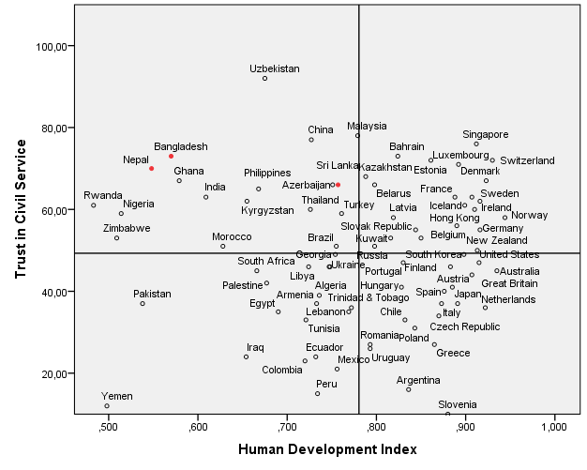
Research Puzzle?
Q 2
Q1
?
Higher Performance
Lower Performance
Q 3
Q 4
Post- Materialism–
rise of critical citizen

Slide 17
Theoretical Explanation and the concept
Authoritarian Cultural Orientation may matter
This concept indicates unquestioning obedience and reliance on authorities and this authority can be government, political leaders, teachers, elders or any one with higher social ranking and reputation (Ma and Yang, 2014).

Slide 18
Operationalization of the Concept
Authoritarian Cultural Orientation Index
Two statements:
  Even if parent’s demands are unreasonable, children still should do what their parents ask/suggest and
  It is natural that those with power, money and belonging to a high status family background should be respected and obeyed.
Respondents choose one option between 1-4 while 1 = strongly disagree and 4 = strongly agree.

Slide 19
Analytical Framework
Citizens’ degree of assertiveness
  Low
  High
Measurement:
  Statement 1: The government is like a parent. It should decide which is good for us and
  Statement 2: The government is like our employee. We are the bosses and should tell government what to do.

Slide 20
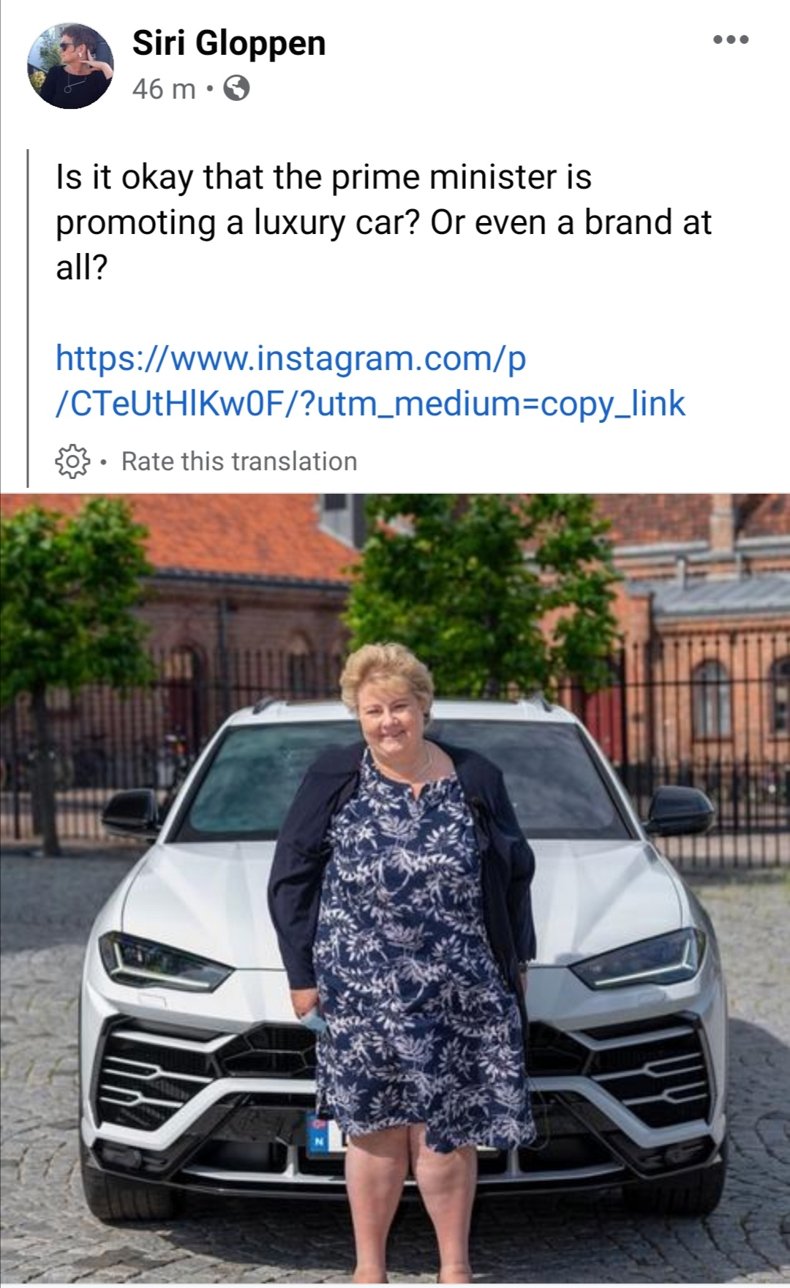

Slide 21
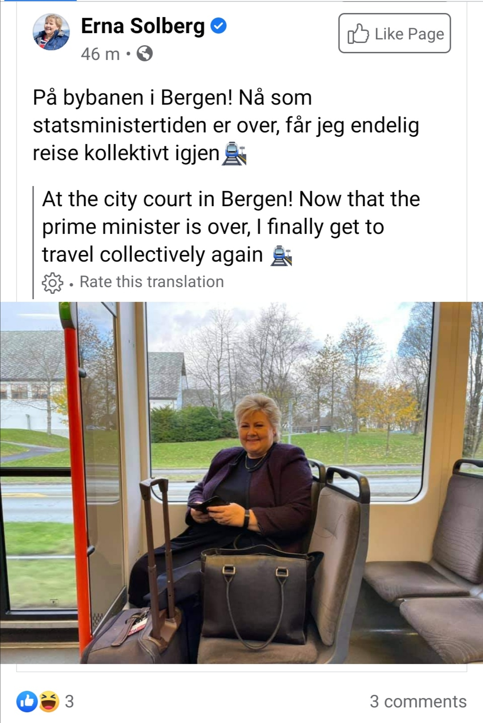

Slide 22
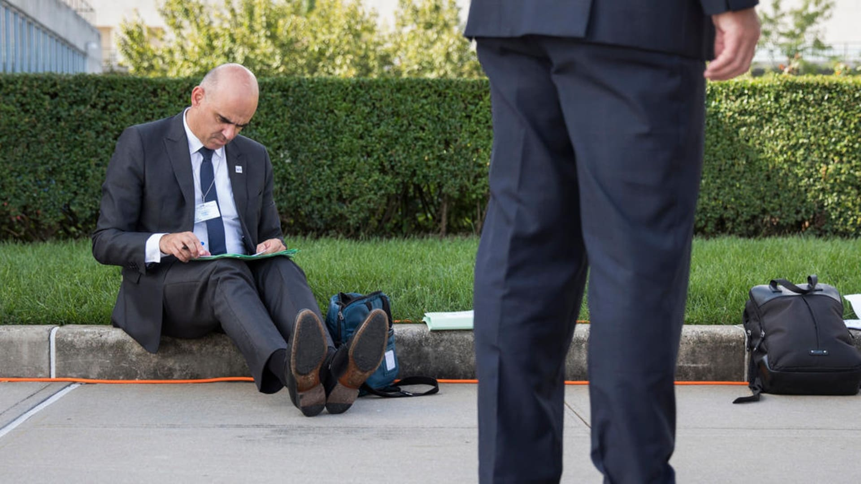
https://www.swissinfo.ch/eng/humble-leadership_down-to-earth-swiss-president-raises-eyebrows/44451134

Slide 23
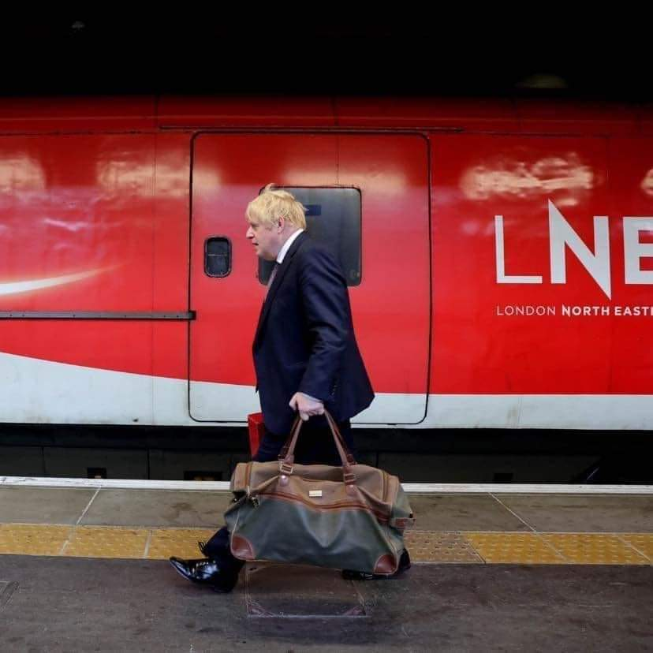

Slide 24
Methodology
5th round of Afrobarometer
  Year: 2015
  34 countries
  Survey response from 51,587 samples

Slide 25
t-test on the variation of institutional trust based on individual’s degree of assertiveness(N= 51,587)
Key Institutions | Degree of Assertiveness | Mean | Std. Deviation | Std. Error Mean | t | Sig (2-tailed) | Mean Difference
Trust key leadership figure (President/Prime Minister) | High | 1.70 | 1.135 | .009 | -25.760 | .000 | -.302
 | Low | 2.01 | 1.065 | .008
Trust parliament/national assembly | High | 1.54 | 1.086 | .008 | -20.084 | .000 | -.230
 | Low | 1.77 | 1.056 | .008
Trust national electoral commission | High | 1.55 | 1.128 | .009 | -16.274 | .000 | -.199
 | Low | 1.75 | 1.077 | .008
Trust tax department | High | 1.35 | 1.078 | .009 | -16.164 | .000 | -.189
 | Low | 1.54 | 1.063 | .008
Trust your elected local government council | High | 1.39 | 1.081 | .009 | -20.546 | .000 | -.239
 | Low | 1.63 | 1.049 | .008

Slide 26
t-test on the variation of institutional trust based on individual’s degree of assertiveness(N= 51,587)
Key Institutions | Degree of Assertiveness | Mean | Std. Deviation | Std. Error Mean | t | Sig (2-tailed) | Mean Difference
Trust the ruling party | High | 1.41 | 1.136 | .009 | -23.834 | .000 | -.285
 | Low | 1.70 | 1.089 | .008
Trust opposition political parties | High | 1.19 | 1.064 | .008 | -3.126 | .002 | -.036
 | Low | 1.22 | 1.046 | .008
Trust police | High | 1.44 | 1.121 | .009 | -24,431 | .000 | -.282
 | Low | 1.72 | 1.091 | .008
Trust army | High | 1.97 | 1.081 | .008 | -8.060 | .000 | -.090
 | Low | 2.06 | 1.026 | .007
Trust courts of law | High | 1.77 | 1.062 | .008 | -11.946 | .000 | -.132
 | Low | 1.90 | 1.029 | .007

Slide 27
t-test on the variation of different aspects of governance based on individual’s degree of assertiveness(N= 51,587)
Key Governance Indicators | Degree of Assertiveness | Mean | Std. Deviation | Std. Error Mean | t | Sig (2-tailed) | Mean Difference
Corruption: office of the President/Prime Minister | High | 1.31 | .872 | .007 | 19.672 | .000 | .192
 | Low | 1.12 | .853 | .007
Corruption: Members of Parliament | High | 1.37 | .801 | .007 | 14.408 | .000 | .128
 | Low | 1.24 | .792 | .006
Corruption: government officials | High | 1.49 | .790 | .006 | 15.925 | .000 | .139
 | Low | 1.35 | .801 | .006
Corruption: police | High | 1.66 | .878 | .007 | 15.364 | .000 | .146
 | Low | 1.52 | .880 | .006
Corruption: tax officials | High | 1.49 | .853 | .007 | 9.925 | .000 | .096
 | Low | 1.39 | .858 | .007
Corruption: judges and magistrates | High | 1.29 | .829 | .007 | 8.606 | .000 | .080
 | Low | 1.21 | .846 | .006
Unequal treatment | High | 1.58 | .990 | .008 | 11.707 | .000 | .122
 | Low | 1.46 | .992 | .007

Slide 28
t-test on the variation of different aspects of governance based on individual’s degree of assertiveness(N= 51,587)
Key Performance Indicators | Degree of Assertiveness | Mean | Std. Deviation | Std. Error Mean | t | Sig (2-tailed) | Mean Difference
Extent of democracy | High | 2.55 | .920 | .007 | -.24.225 | .000 | -.235
 | Low | 2.79 | .905 | .007
Freeness and fairness of the last national election | High | 2.95 | 1.118 | .009 | -.21.205 | .000 | -.244
 | Low | 3.19 | .998 | .007
Managing the economy | High | 2.07 | .954 | .007 | -17.587 | .000 | -177
 | Low | 2.25 | .943 | .007
Improving living standards of the poor | High | 1.89 | .893 | .007 | -15.415 | .000 | -.145
 | Low | 2.03 | .890 | .006
Creating jobs | High | 1.78 | .864 | .007 | -21.072 | .000 | -.194
 | Low | 1.97 | .884 | .006
Keeping prices down | High | 1.63 | .819 | .006 | -20.648 | .000 | -.181
 | Low | 1.81 | .852 | .006
Narrowing income gaps | High | 1.71 | .832 | .007 | -18.091 | .000 | -.162
 | Low | 1.87 | .858 | .006
Reducing crime | High | 2.34 | .986 | .008 | -8.645 | .000 | -.089
 | Low | 2.43 | .967 | .007

Slide 29
t-test on the variation of different aspects of governance based on individual’s degree of assertiveness(N= 51,587)
Key Performance Indicators | Degree of Assertiveness | Mean | Std. Deviation | Std. Error Mean | t | Sig (2-tailed) | Mean Difference
Improving basic health services | High | 2.51 | .940 | .007 | -12.922 | .000 | -.125
 | Low | 2.63 | .905 | .006
Addressing educational needs | High | 2.58 | .956 | .007 | -11.010 | .000 | -.108
 | Low | 2.69 | .905 | .006
Providing water and sanitation services | High | 2.20 | .970 | .008 | -9.475 | .000 | -.096
 | Low | 2.30 | .950 | .007
Ensuring enough to eat | High | 1.93 | .897 | .007 | -14.867 | .000 | -.141
 | Low | 2.07 | .904 | .006
Fighting corruption | High | 2.03 | .990 | .008 | -16.637 | .000 | -.176
 | Low | 2.21 | .963 | .007
Resolving violent conflict between communities | High | 2.50 | .964 | .008 | -11.431 | .000 | -.118
 | Low | 2.62 | .929 | .007
Combatting HIV/AIDS | High | 3.01 | .924 | .007 | 1.298 | .194 | 0.13
 | Low | 3.00 | .884 | .006
Maintaining roads and bridges | High | 2.28 | 1.010 | .008 | -9.577 | .000 | -.101
 | Low | 2.38 | .984 | .007
Providing reliable electric supply | High | 2.15 | 1.009 | .008 | -7.212 | .000 | -.078
 | Low | 2.22 | .996 | .007
Empowering women | High | 2.73 | .951 | .008 | -3038 | .000 | -.30
 | Low | 2.76 | .904 | .007

Slide 30
t-test on the variation of the willingness to pay taxes based on individual’s degree of assertiveness (N= 51,587)
 | Degree of Assertiveness | N | Mean | Std. Deviation | Std. Error Mean | t | Sig (2-tailed) | Mean Difference
Need to pay taxes | High | 15,004 |  | 1.235 | .010 | 5.124 | .000 | .065
 | Low | 18,344 |  | 1.062 | .008
2.14
2.07

Slide 31
Suggested readings
Baniamin, H. M., Jamil, I., & Askvik, S. (2019). Mismatch between lower performance and higher trust in the civil service: Can culture provide an explanation?. International Political Science Review, 0192512118799756.
Baniamin, H. M. (2019). Linking socio-economic performance, quality of governance, and trust in the civil service: does culture intercede in the perceived relationships? Evidence from and beyond Bangladesh, Nepal and Sri Lanka. Asia Pacific Journal of Public Administration, 41(3), 127-141.
Baniamin, H. M. (2020). Linking trust, performance, and governance quality: What can explain the incongruity? Trustgov-A joint project by University of Southampton and Harvard Kennedy School, Harvard University. Available online at: https://static1.squarespace.com/static/5c21090f8f5130d0f2e4dc24/t/5ea6e9dcad6d2b7cb62b1366/1587997162470/WP002-Baniamin_Africa_institution.pdf.

Slide 32
Q?

